Slide 1


BoM ACCESS priorities/directions.
Gilbert Brunet
Chief Scientist Group Executive | Science and Innovation Group

Slide 2


Slide 3
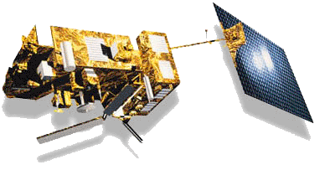
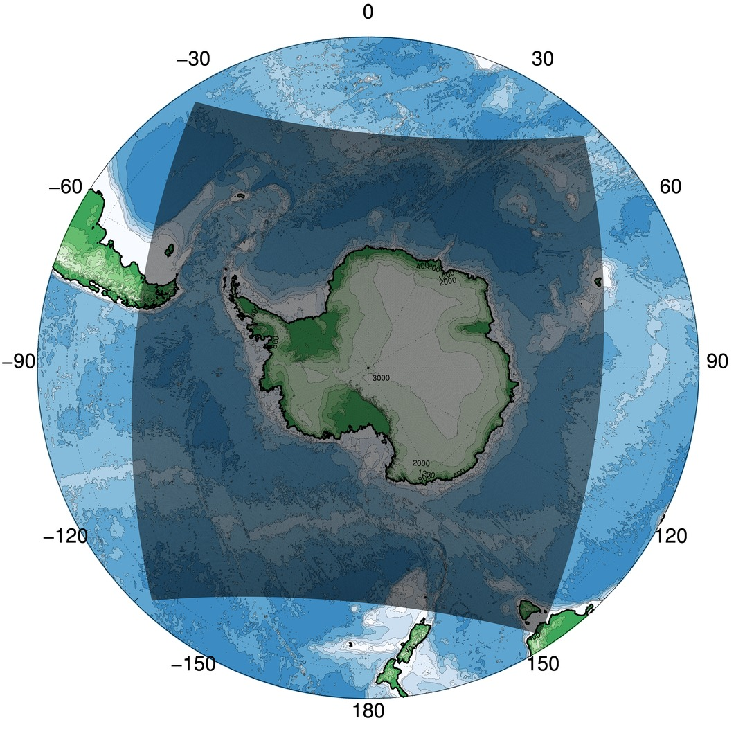
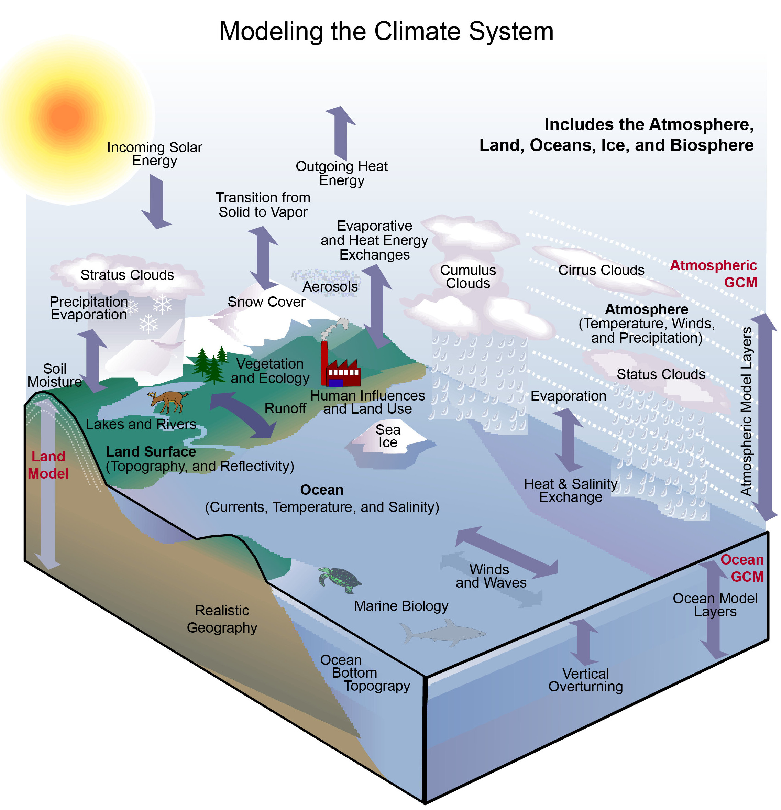

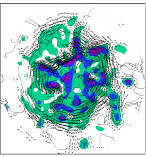
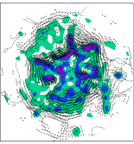
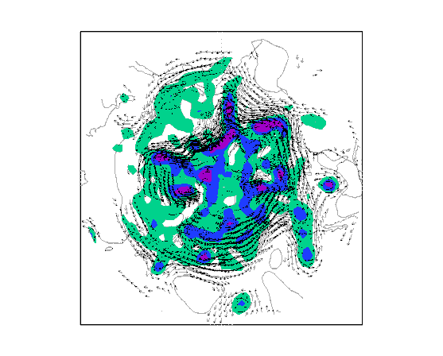
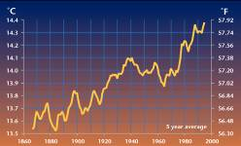
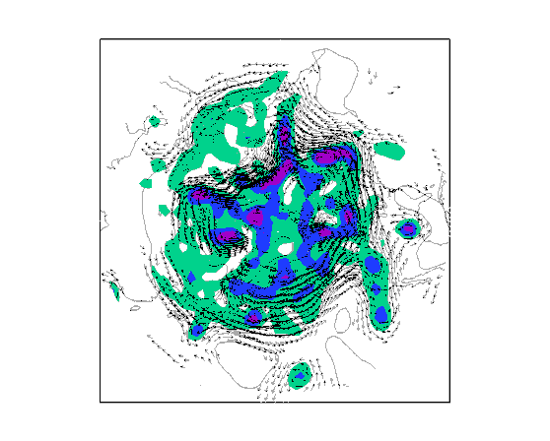
The priorities of the Bureau for 2020-30 in partnership with UKMO, CSIRO …
Enhanced customer experience:
more accurate and timely forecasts with
20-30 Millions Observations per day
by 2030
Improved value and impact for customer:
fully integrated Atmosphere/Ocean/
Sea-ice/Hydrology forecasts
by 2025-30
Customer focus:
Better urban and regional
forecasts
for all important Australian
cities and catchments
with hourly predictions
Earth Observation
Antarctica Services
Resolution
Computing
Resources and
Staff
Complexity
Long term customer insights:
Climate Services jointly with CSIRO offering
sub-seasonal to multi-decadal predictions,
downscaled projections and attribution information
Duration and/or Ensemble size

Slide 4
Australian Community Climate and Earth System Simulator ACCESS
Weather hours to week 1.5km – 12km
Atmosphere Unified Model
Seasonal weeks to months 60km
Atmosphere Unified Model
Land-surface JULES / CABLE
Climate decades to centuries 60km – 150km
Atmosphere Unified Model
Land-surface CABLE
Ocean GFDL - MOM
Sea-ice CICE
Carbon & chemistry UKCA, CASA-CNP, WOMBAT
Land-surface JULES
Ocean NEMO
Sea-ice CICE
Data Assimilation Atmosphere
Data Assimilation Atmosphere – Land-Oceans
Scheduler ROSE-CYLC
Scheduler ROSE-CYLC
Scheduler ROSE-CYLC
An unified numerical forecasting system for seamless applications
Weather meets Climate: reanalysis and downscaling
Is more unification needed as we face the Exascale challenge?
100% BOM (+Uni's↑)
90% BOM + (+Uni's↑)
90% CSIRO (+Uni's↑)
Deterministic and ensemble
Probabilistic
Scenario

Slide 5
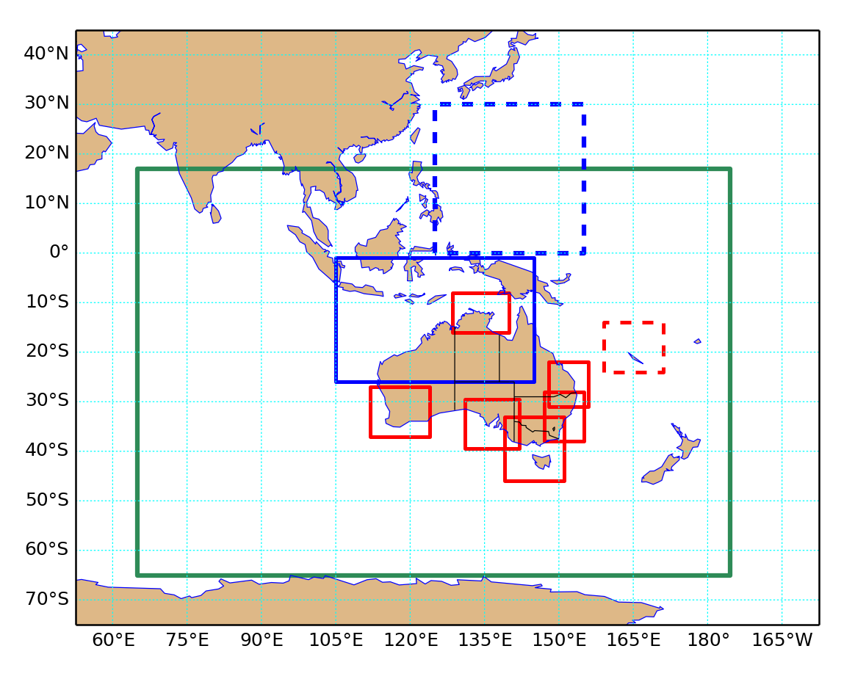
Numerical Environmental and Weather Prediction: BoM ACCESS directions
ACCESS Parallel Suite (APS)
Embracing the Unified Model (UM) partnership with UKMO, CSIRO, KMA …
Challenges
An adaptive and responsive weather, climate and water knowledge agenda informed by deep customer and partner insight and understanding;
Future HPC and supercomputer investments, software platform and tools ( Exascale, Lfric …).
Data: volume and speed
ACCESS-G (global)
ACCESS-TC
(relocatable)
ACCESS-TCX
ACCESS-Reanalysis
ACCESS-C

Slide 6
Thank you.
Q&As

